Slide 1
CS 419: Production Rendering Ray-Tracing Basics
Eric Shaffer
Some slides adapted from CS348b: Image Synthesis by Matt Pharr

Slide 2
Our Model of Light Rays
Three key ideas about light rays
Light travels in straight lines (mostly)
Light rays do not interfere with each other if they cross
Light rays travel from light sources to the eye, but the physics is invariant under path reversal–reciprocity
Why is reciprocity important to us computationally?

Slide 3
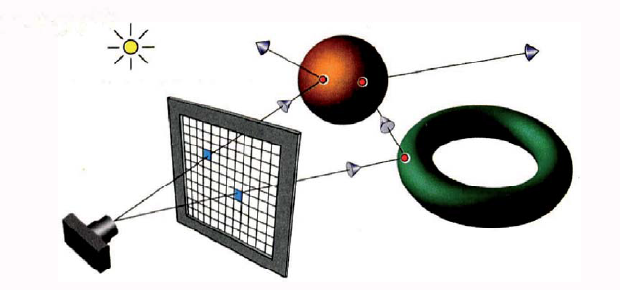
Ray Tracing
Figure from Ray Tracing from the Ground Up by Kevin Suffern

Slide 4

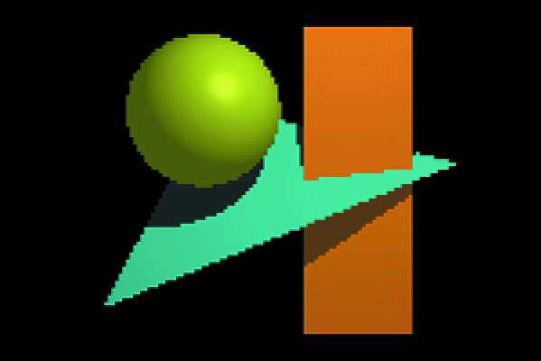
Resolution

Slide 5
Ray Tracing – basic algorithm
define some objects
specify a material for each object
define some light sources
define window that consists of a grid of pixels (the view plane)
for each pixel
shoot a ray into the model world
compute the intersection of the ray with each object
find the intersection (if any) closest to the view plane
if there was an intersection
use lights and material to compute the pixel color
else
pixel is set to background color

Slide 6
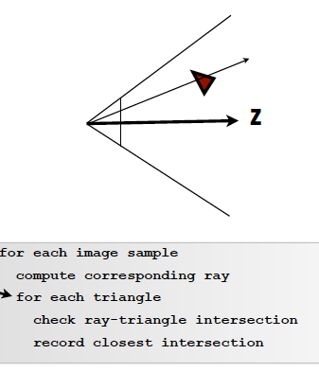
How Does Ray Tracing Differ from Rasterization?

Slide 7
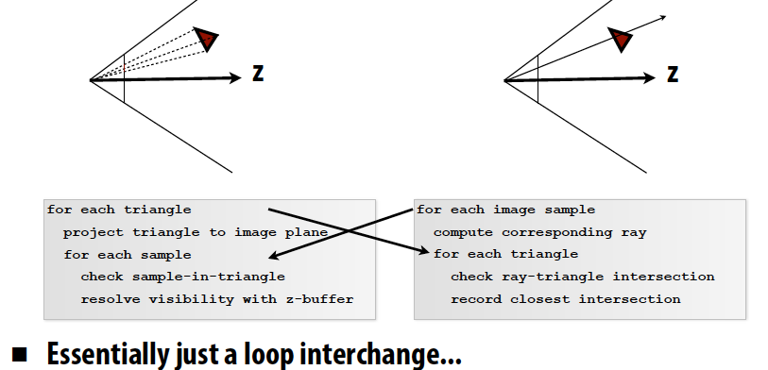
How Does Ray Tracing Differ from Rasterization?
Slide from CS348b: Image Synthesis by Matt Pharr

Slide 8
Well…actually we’re ray-casting
We can also cast some other rays to achieve other effects
That’s when we are able to say we ray-tracing
Types of rays:
Primary rays – rays shot from pixel (or eyepoint) into the world
Secondary rays
Shadow rays
Light rays
Notes:
What is the difference between pixel and eyepoint? What do we achieve?
Secondary rays are reflected rays – what kind of effect?
Shadow rays let us do shadows -- how could we do that? Where do they start and end?
Light rays start at the light. What effect do they give us? Why don’t we start the primary rays at the light?

Slide 9
Orthographic ray-tracing
Figure from Ray Tracing from the Ground Up by Kevin Suffern

Slide 10
Orthographic ray-tracing
Figure from Ray Tracing from the Ground Up by Kevin Suffern

Slide 11
Rays
p is a point on the ray
o is point that is origin of the ray
t is scalar parameter
d is unit vector giving the direction of the ray

Slide 12
Intersecting Rays and Implicit Surfaces
We can intersect an implicit surface with a ray
Just find the point p on the ray that satisfies the equation for the implicit surface
For now, we’ll just focus on planes and spheres….

Slide 13
Plane Equation
Here a is a point on the plane And n is the normal
All points p that satisfy the equation form the plane

Slide 14
Ray-Plane Intersection
the plane equation with normal n and point on plane a
What happens if d is parallel to the plane?
How do you know if the hit happens in front or behind the view plane?

Slide 15
Ray-Sphere Intersection
Equation of a sphere
So…a quadratic equation that we can solve

Slide 16
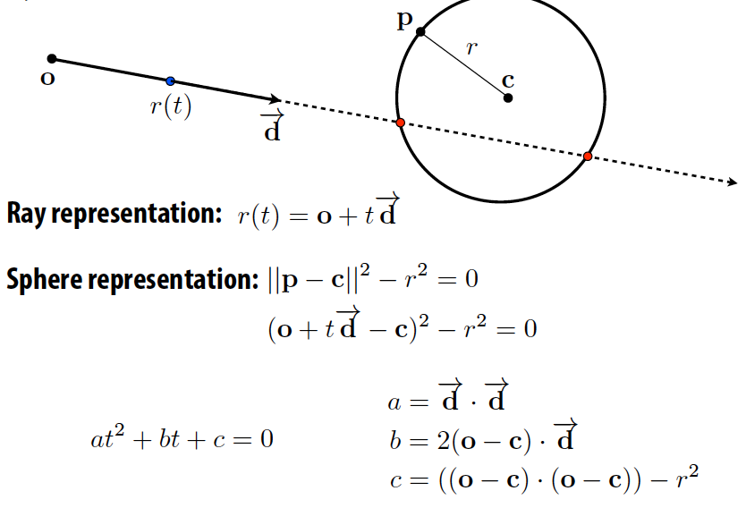
Ray-Sphere Intersection
Slide from CS348b: Image Synthesis by Matt Pharr

Slide 17
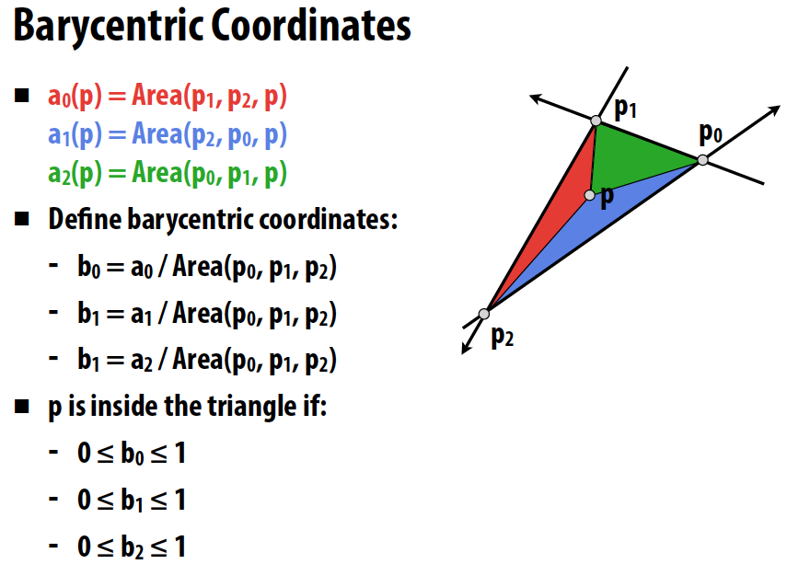
Point in Triangle Test
←should be b2
Slide from CS348b: Image Synthesis by Matt Pharr
Notes:
Can you implement a ray-triangle intersection test?

Slide 18
Barycentric Coordinates for Triangles
Describe location of point in a triangle in relation to the vertices
p=(λ₁,λ₂ ,λ₃) where the following are true
p=λ₁a + λ₂ b +λ₃c
λ₁+λ₂ +λ₃= 1
To interpolate a function sampled
at the vertices we just do:
f(p)=λ₁f(a) + λ₂ f(b) +λ₃f(c)
a
p
b
c

Slide 19
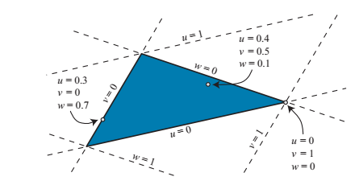
Barycentric Coordinates for Triangles
From Real-Time Rendering, 4th Edition

Slide 20
Barycentric Coordinates for Triangles
So we have:
λ₁= AREA_{cbp}/AREA_{abc}
λ₂= AREA_{cap}/AREA_{abc}
λ₃= AREA_{bap}/AREA_{abc}
How can a subtriangle have a negative area?
a
Coordinates are the signed area of the
opposite subtriangle divided by area of the triangle
A_{cap}
A_{bap}
p
A_{cbp}
b
c

Slide 21
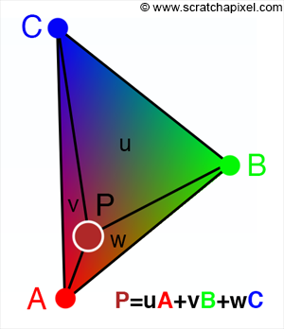
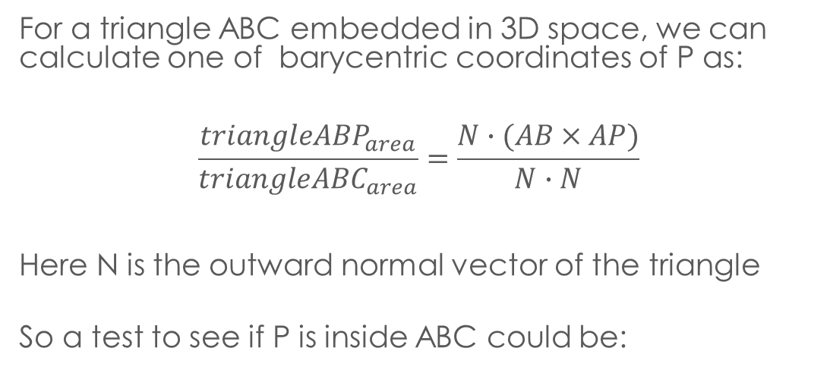
Calculating Triangle Area
For a triangle ABC embedded in 3D space, we can calculate one of barycentric coordinates of P as:
$$\frac{{triangleABP}_{area}}{{triangleABC}_{area}}=\frac{N∙(AB×AP)}{N∙N}$$ Here N is the outward normal vector of the triangle So a test to see if P is inside ABC could be:
// edge 0 Vec3f edge0 = v1 - v0; Vec3f vp0 = P - v0; C = edge0.crossProduct(vp0); if (N.dotProduct(C) < 0) return false; // P is on the right side
Repeat for the other two coordinates… how can we optimize test?

Slide 22
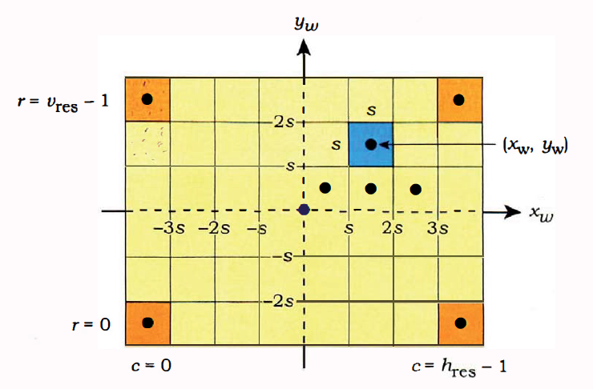
Computing Pixel Coordinates

Slide 23


What Changed?

Slide 24
Changing Field of View

Slide 25

Code from the book…
You absolutely can use the “barebones” code…
I haven’t done it…

Slide 26
Implementation Tips
Don’t feel compelled to use the code from the book
It may be easier to write it yourself
Choose a good, easy-to-use library for vector-matrix math
Python and numpy are decent
…feel free to post suggestions on piazza
Debug using single pixel images when possible
Use test-driven development
As you incrementally add functions…
…write test executables for all major functions

